Slide 1

Substructure Ordering

Slide 2

To Start:
When starting to order substructure maps it is best to open the Jurisdictional KMZ, Jurisdictional Contact list, and the internet explorer .
Jurisdictional KMZ
Jurisdictional Contact List
Internet Explorer
Notes:
Here is where the notes go.

Slide 3
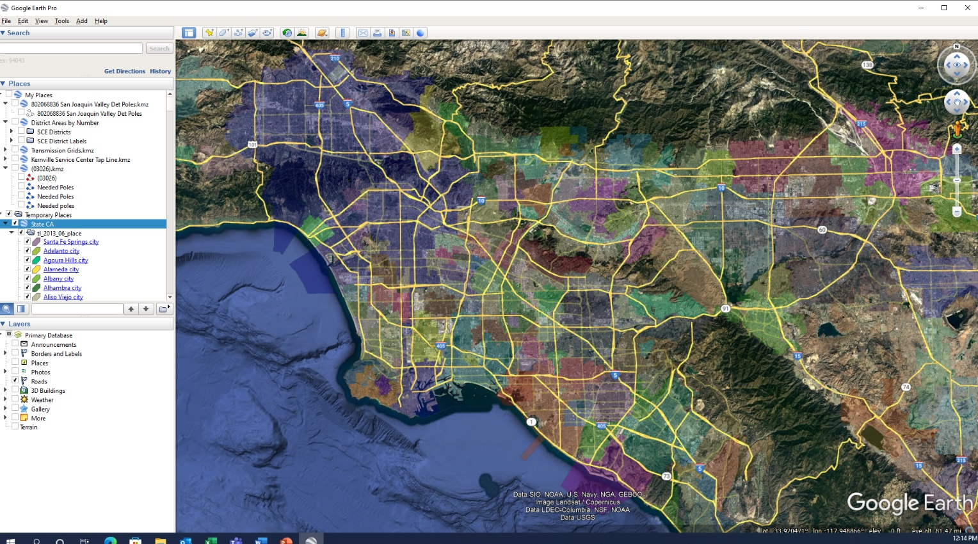
Step 1: Open Jurisdictional KMZ
Jurisdictional KMZ can be found in the server. Titled “State CA”
Path:
Z:\Permit and UtilityDocumentation\Jurisdictions
All Jurisdictions are color coded

Slide 4
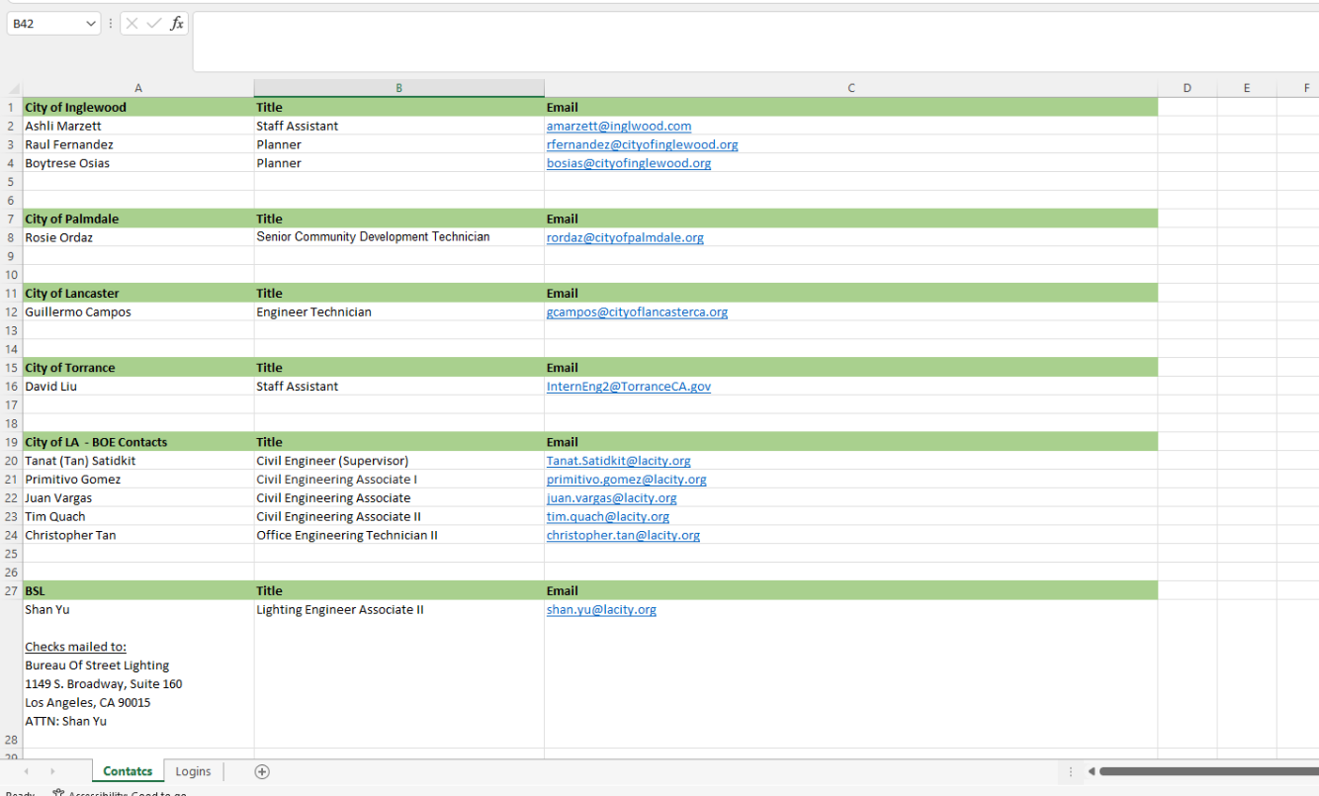
Step 2: Open Jurisdictional Contact List
Our internal contact list can be used to start your research and call the Public Works department. Titled “City Contacts and PW”
Path:
Z:\Permit and Utility Documentation\Jurisdictions
If we are going to a new jurisdiction that is not on our existing list, please add the new contact information.

Slide 5
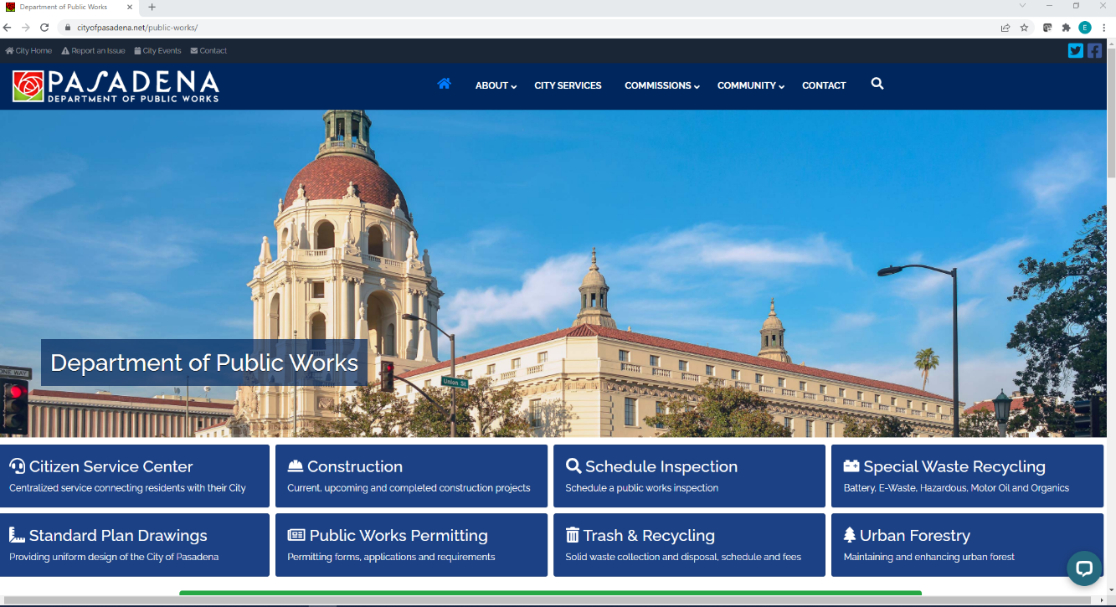
Step 3: Open Jurisdictional Contact List
Visit the jurisdictional website and go into:
City Website>City Departments>Public Works>Contact
There are 3 goals for this task:
1. Have the city provide us substructure maps that they might have.
2. Have the city and get us list of utility companies within the city boundaries (contacts would help)
3. Most of the time a city will have a Utility contact list on the website. https://www.cityofpasadena.net/public-works/wp-content/uploads/sites/29/Utility-Contact-List.pdf?v=1646945169564

Slide 6
Jurisdictional Call “Roll-Play”
“Hello,
My name is __________, I’m calling on behalf of ___________. We are trying to obtain substructure maps to assist with a project we are going to be applying for in you City/County. What department or who can best get me the correct items that I need?”
Once you get to the right person or place, we will try to order substructure maps from each utility in our proposed project area.

Slide 7
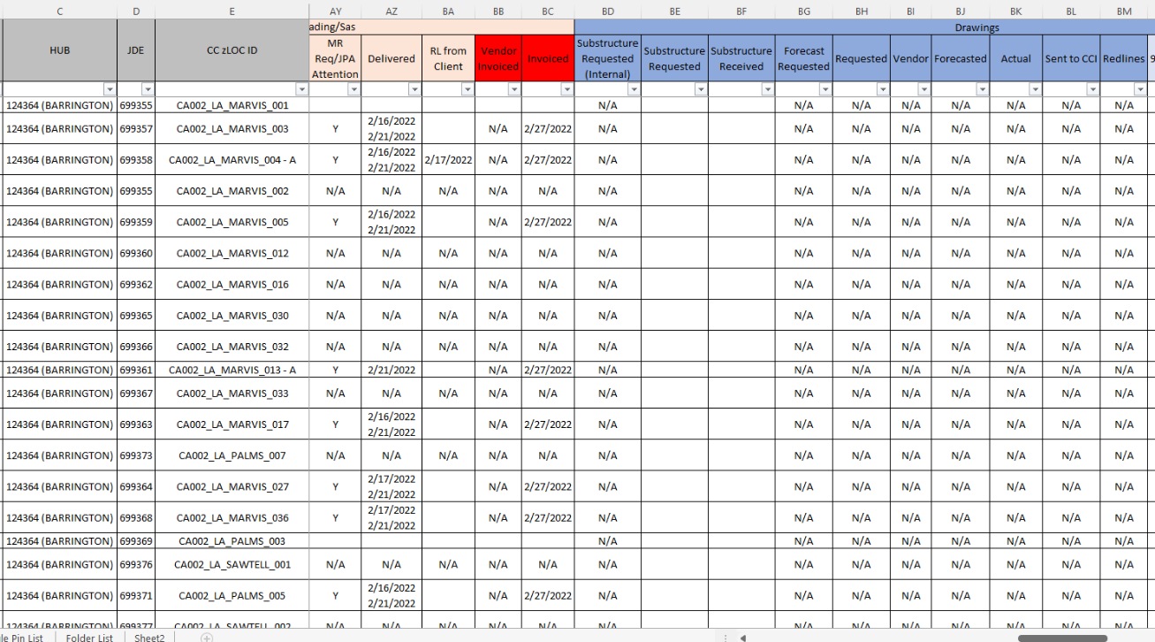
Step 4: Open Project Checklist
Open Project Tracker and Checklist
Path:
Complete dates, fees,

Slide 8
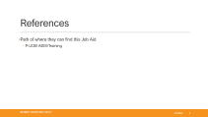




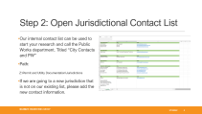
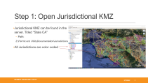
Summary

Slide 9
References
Path of where they can find this Job Aid
P:\JOB AIDS\Training

