Slide 1
IKE-4 Training

Slide 2

Agenda
IKE 4 – Introduction to IKE Field & IKE Office
Presentation
Form Creation
IKE Tools
HOA’s
Data Output
IKE 4 – Web demonstration of IKE Field
Brief Video on Pole Data Collection
IKE 4 – Web demonstration of IKE Office
Adding Fields to an IKE Collection Form
Marking HOA’s in IKEphoto
Data Output

Slide 3
Introduction
Matthew Worster
Solutions Deployment Manager
matthew.worster@ikegps.com
720.323.2273
Jarrod Phillips
Support Engineer
Jarrod.Phillips@ikegps.com
406.274.4982

Slide 4
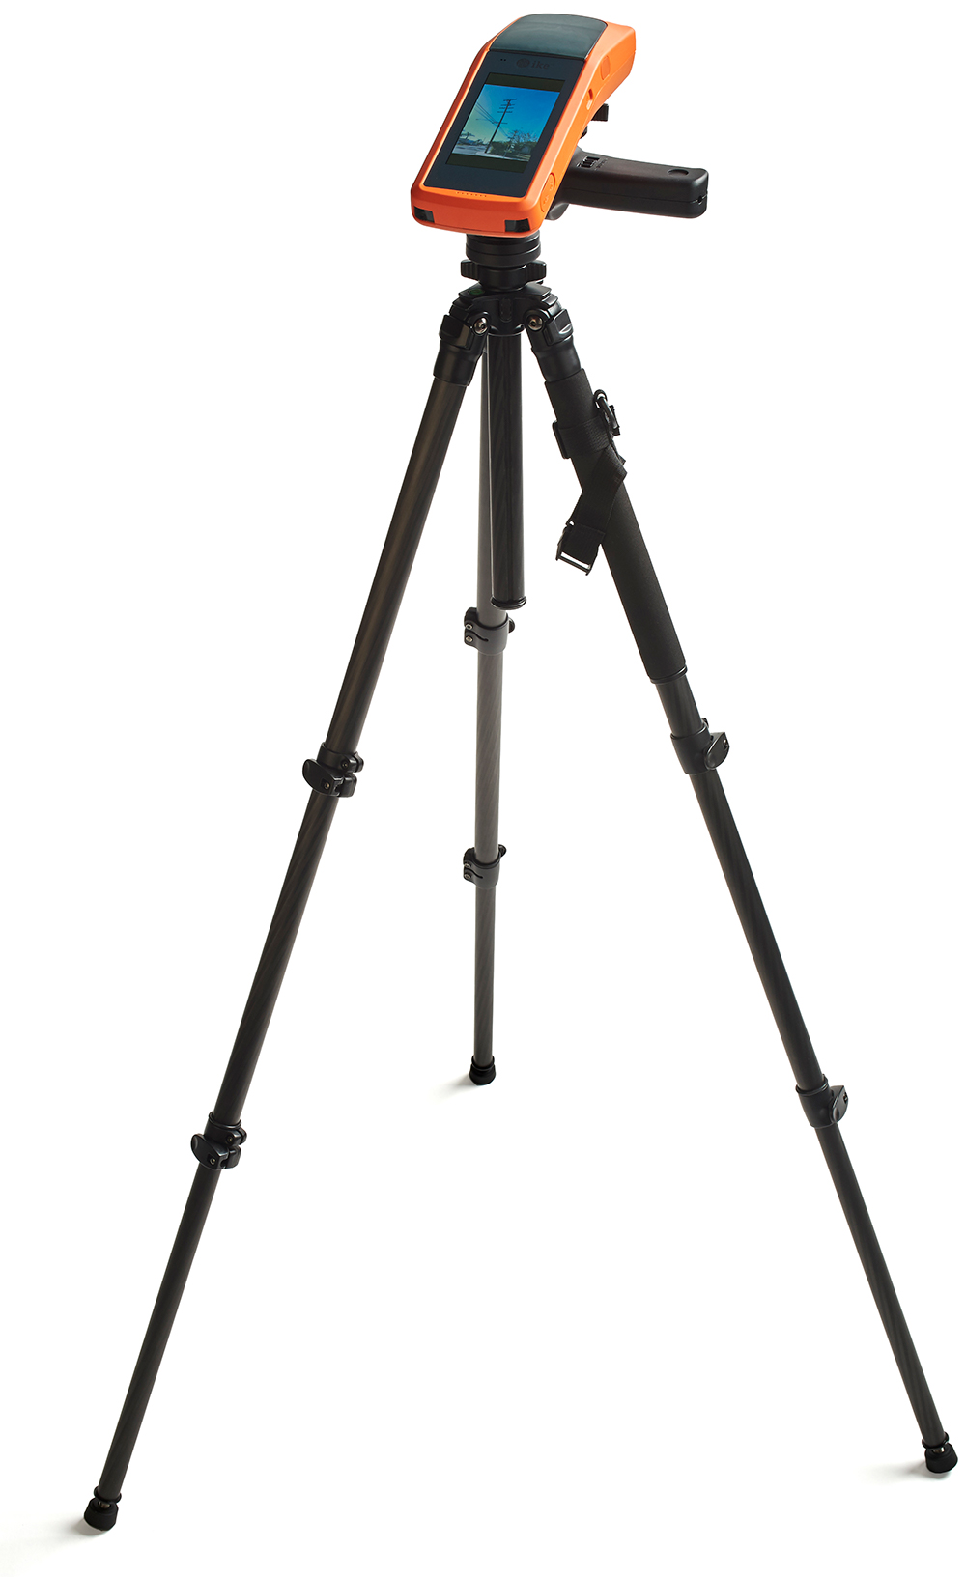
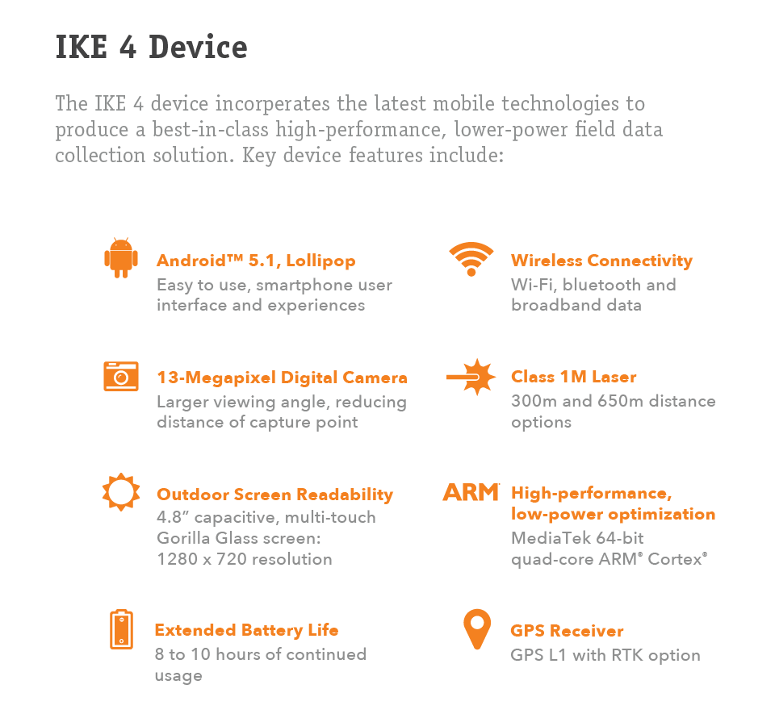

Slide 5
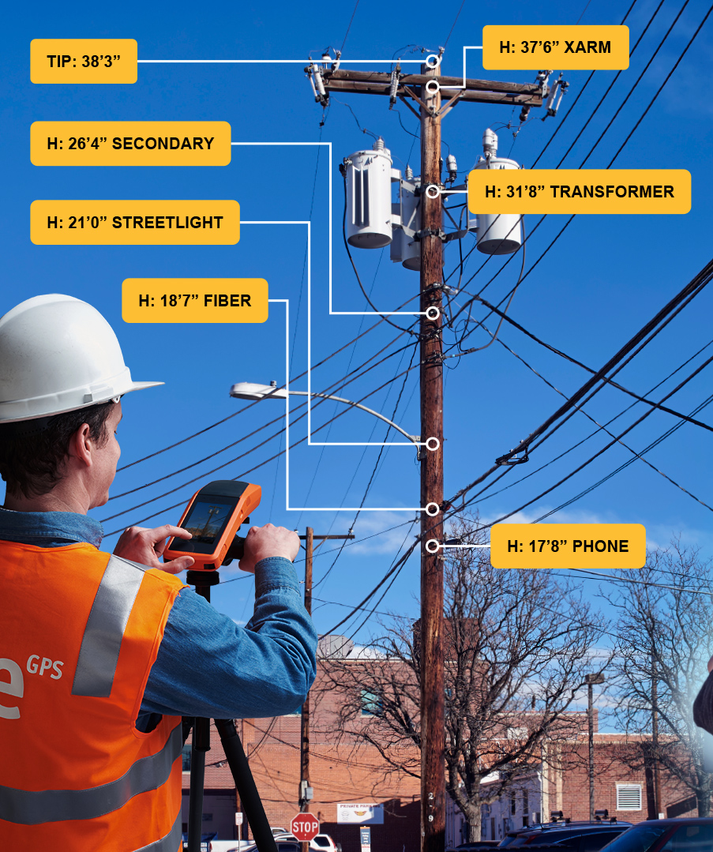
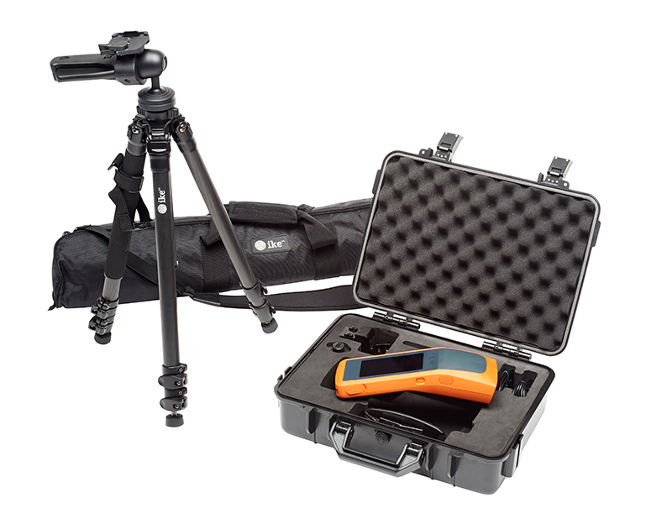
Complete Solution

Slide 6

Software Modules
IKE Field & Office
IKE Integration
Capture Tools
Form Design
Pole Loading
Photo Measure
Photo Only
Point to Point
Span Height
Target Position
Local Position
Nested / Sub-forms
Customizable
Multiple data collection option
3rd Party Pole Load Integration
SPIDACalc
PoleForeman
O-Calc Pro*
Photo Measurement
Standard Data Output
Height
Width
Measurements are linked to real world objects
JSON, Print, KMZ, Excel
Wireless Support
FME Cloud
WiFi
Bluetooth 4.0
Over 350 formats (.dwg, .shp, etc.)

Slide 7
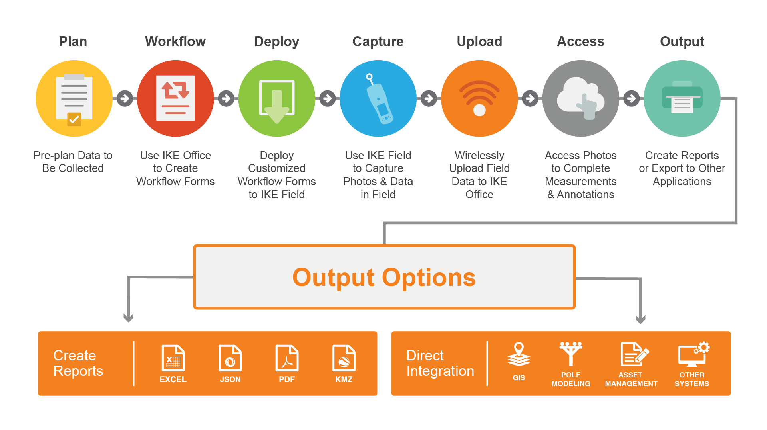
IKE 4 Generic Workflow

Slide 8
Adding IKE Users

Slide 9

IKE Office
Cloud-based software that allows for field data collection and analysis… your way!
Ability to modify forms/workflows & reports so the data is captured in the most productive method for your organizational needs.
Perform additional pole measurements from initial field measurements
Flexibility to import data and send updated forms directly to the field with Wi-Fi or hot spot Connection

Slide 10
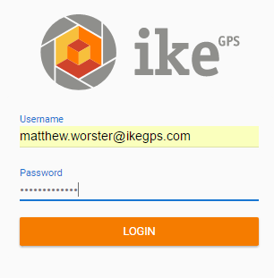
IKE Office (Login)
https://office.ikegps.com/#/login
Notes:
Not sure if I am sold on the orange shadow box. Kind of indifferent I guess. Maybe smaller shadow if there’s nothing better

Slide 11

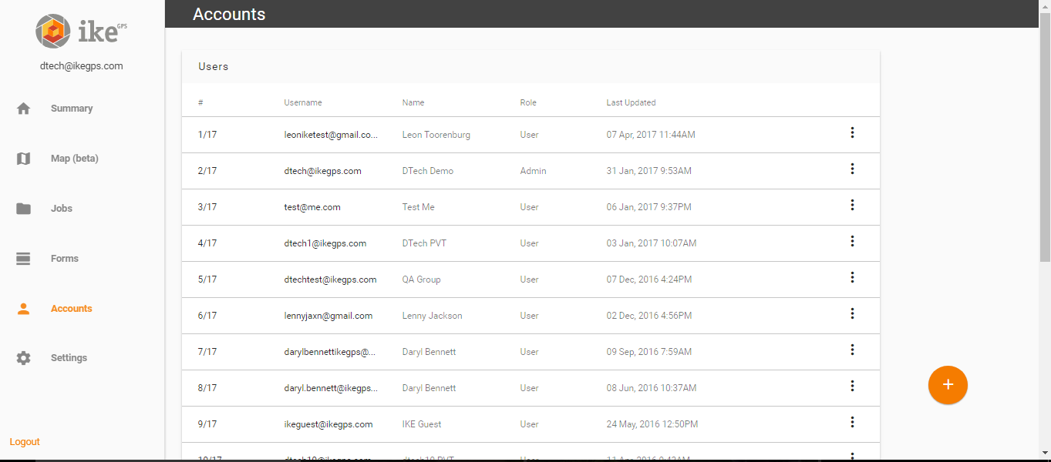
Accounts Page (Add/Manage Users in Company Account)

Slide 12
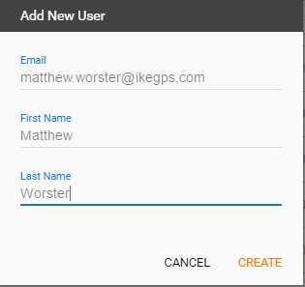
Adding User Accounts
Email address must be unique
Admin has ability to reset password and delete users
Pre-generated password will be given when user account is created

Slide 13
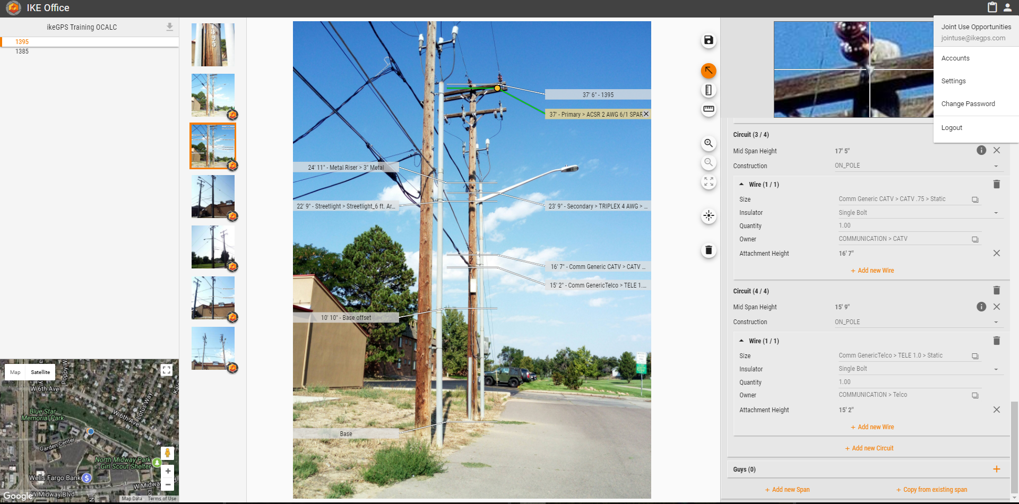
Settings Screen (Change Passwords/Measurement Units)
Username & password is used to login to IKE Field & IKE Office
Reset your password to something easily remembered
Notes:
Can we make the lines and the boxes show up at once for each segment. I.e. show the Username box with the line… then show the reset box with the line

Slide 14
Creating IKE Forms & Workflows

Slide 15
Work Flow Forms
Advance planning of all projects and identifying the exact data needed to support the end result, is very important to the success of a project using IKE. Forms should be developed to support the desired end-result!
What data should field teams collect?
Develop forms and workflow to support data needed
Create form within IKE Office software
When form is ready, deploy to IKE Device
Pre-planning is critical to ensure one trip to the pole!

Slide 16
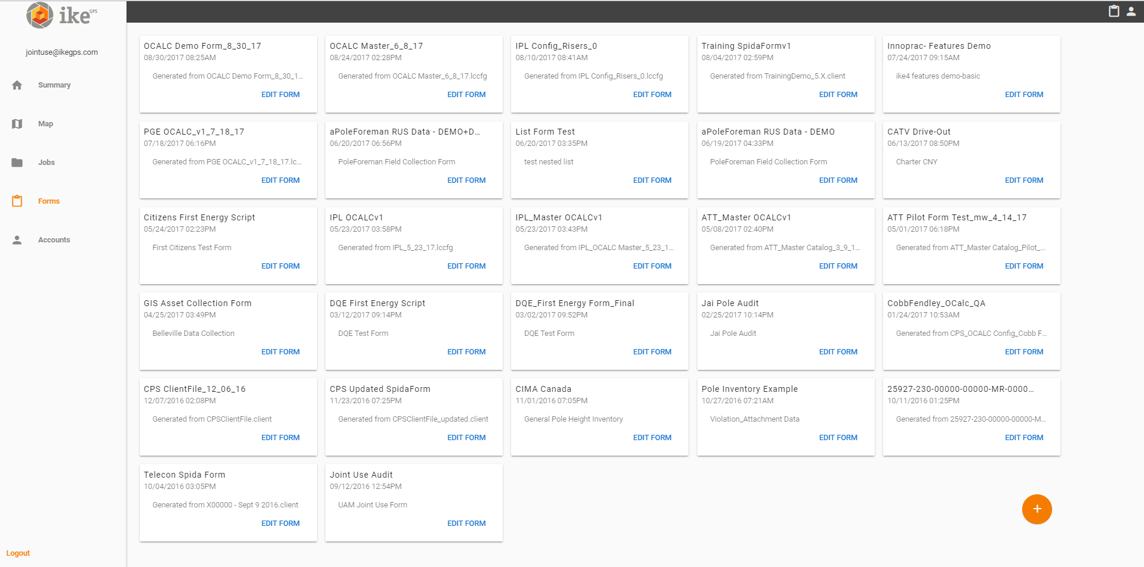
Forms Tab (Create Project Specific Forms)
New Form
Notes:
Show line, circle and new form box at once

Slide 17
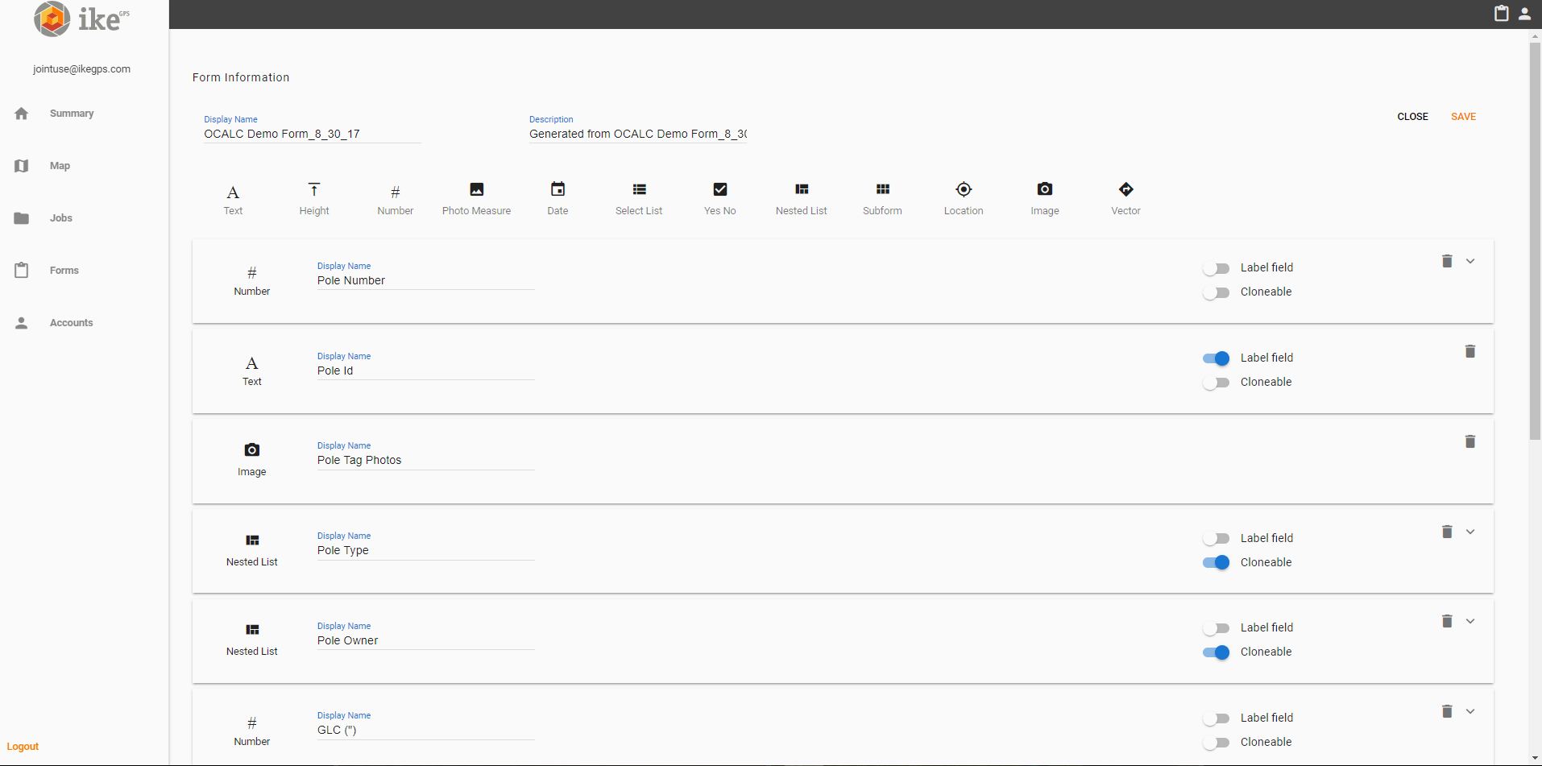
Forms (Drag/Drop/Drop Functionality)
Label Field: Shows as Label in IKEphoto
Cloneable Field: Carries data into next pole added in IKE Field
Notes:
Same here… show label field box and line… then show cloneable field box and line after

Slide 18
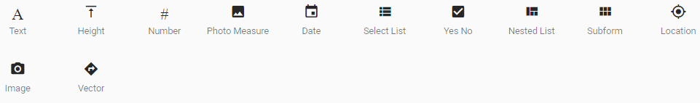
IKE Tools
Text – Alphanumeric
Height – Span Height Tool (MidSpan and Vertical P2P Measurements)
Allows for height tool use in field, manual data entry, or adding within IKEphoto in office
Photo Measure – IKEphoto (calibrated image)
List – Picklist
Nested List – Up to 3 Levels of Conditional Data
Subform – Allows for Grouping of Data
Subform allows for multiple data items to be added in the field
Location – Target Position (laser) or Local Point (device)
Image – Image Only
Vector – Horizontal P2P Measurements (horizontal/slope/vertical distance & bearing)

Slide 19
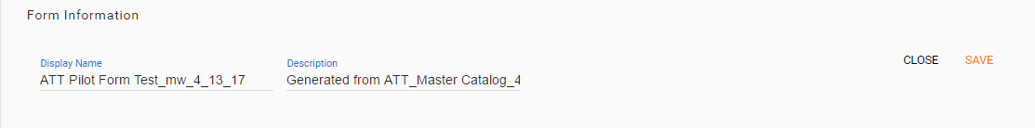
Deploy Form to IKE Field
Select Save once all items have been added to form
Form is pushed to IKE Cloud
Login to IKE Field on Device
Select form tab
Download available form – Wi-Fi connection or mobile hot spot

Slide 20
Introduction to IKE Field Tools

Slide 21



IKE Field
An Android mobile app can be downloaded on the IKE Device (via Google Play Store – search for “IKE Field”). The app contains general measurement tools for field data collection and specialized utility pole measurements for:
Heights
Span lengths
Attachment points
GPS location
Notes:
Need a picture of the IKE4 device and not a cell phone.

Slide 22
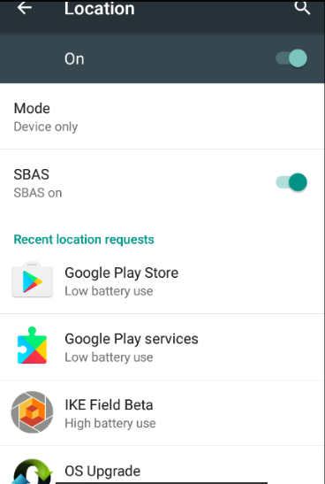
Android Settings
Set Location to:
Device Only
SBAS On
Notes:
Ike device instead of cell phone

Slide 23
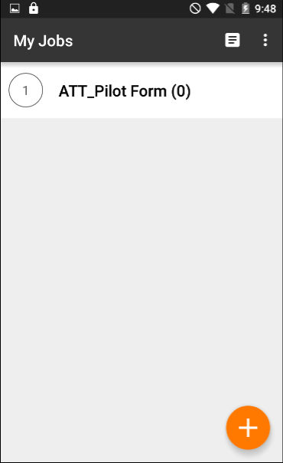
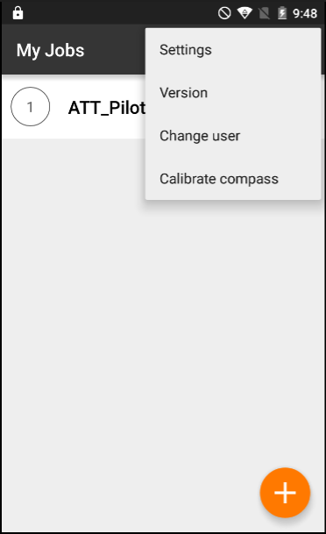
IKE Field (App Navigation)
Forms
Settings
Notes:
Ike device instead of phone. Bring in boxes/lines one at a time

Slide 24
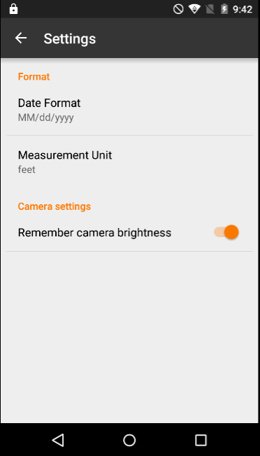
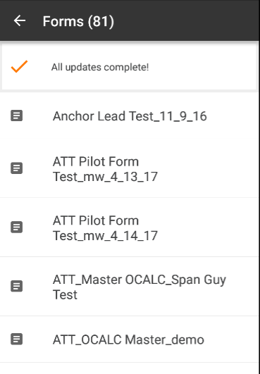
IKE Field (Settings & Forms)
Notes:
Ike device instead of phone.

Slide 25
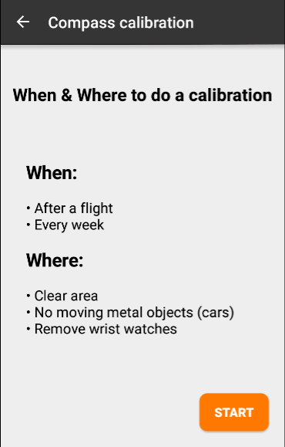
Compass Calibration (Once/Week)
https://ikegps.com/ike-4-compass-calibration/
Select START and follow instructions
Notes:
Ike device instead of phone.

Slide 26




IKE Tools
Measurement | Industry Requirement | Description | IKE 4 Accuracy
GPS Points | Sub Meter | Latitude, Longitude | Sub Meter CEP
Height Above Ground (HAG): Pole Height Height of Attachment (HOA): Wire, Equipment Attachment Height | +/- 2” | Measured on IKEphoto | +/- 2”
Span Length | +/- 24” | Measured in the field between poles known as a span | 1.5% of distance
Line Angles | +/- 5° | Compass bearings measured in the field of Conductor/Cable Tap Span, Service Drop (reference true geodetic North) | +/- 5°
Anchor/Guy Lead Length | +/- 6” | Measured in the field from face of pole to anchor in-ground point | 1.5% of distance
Mid-Spans HAG | +/- 2” | Measured in the field | +/- 2”
Location
IKEphoto
Photo Measure
Height
Vector
Bearing

Slide 27
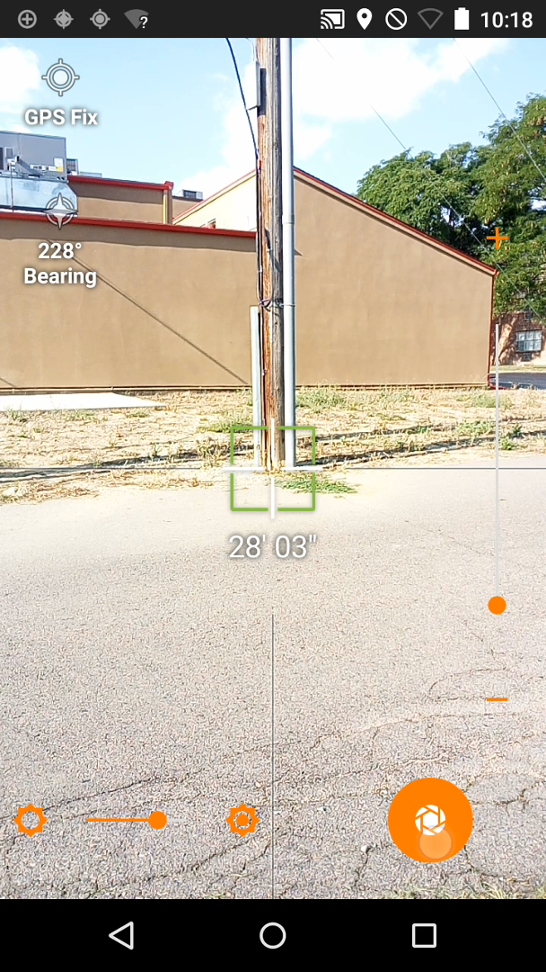
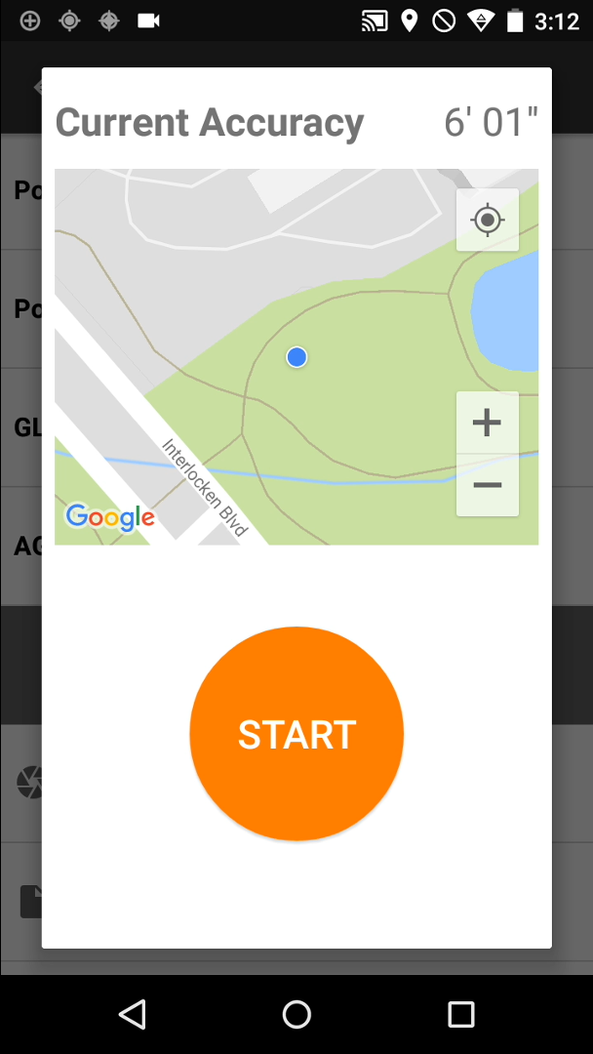
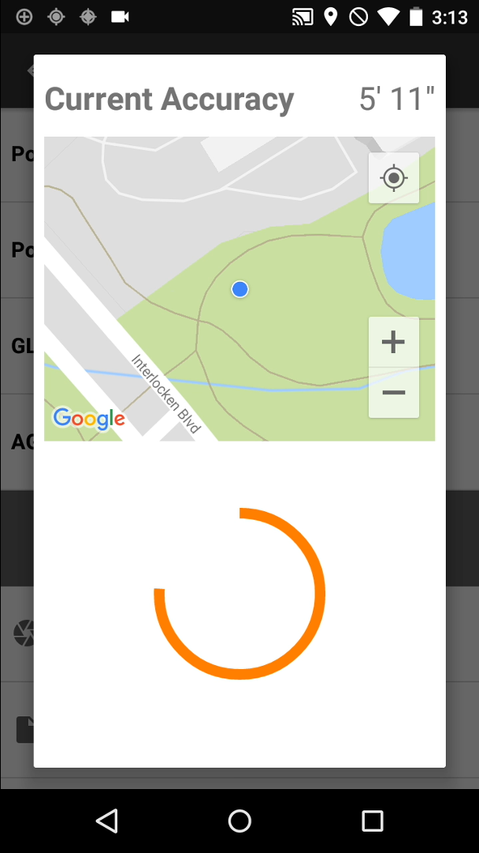
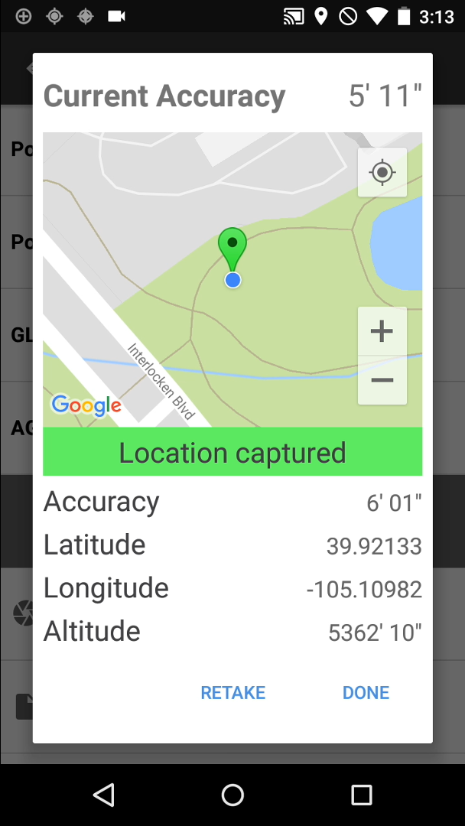
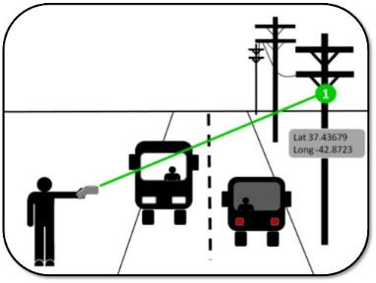
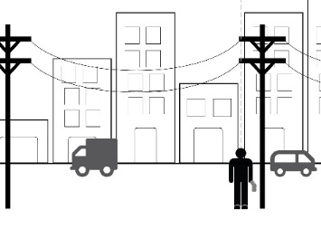

Location
Target Position
Calculated from Device GPS & Laser Target
Local Point
GPS reading from the Device Location
30-second countdown
Note: Location needs to be set to Device Only and SBAS on
Target Position
Local Point
Target Position
Local Point

Slide 28
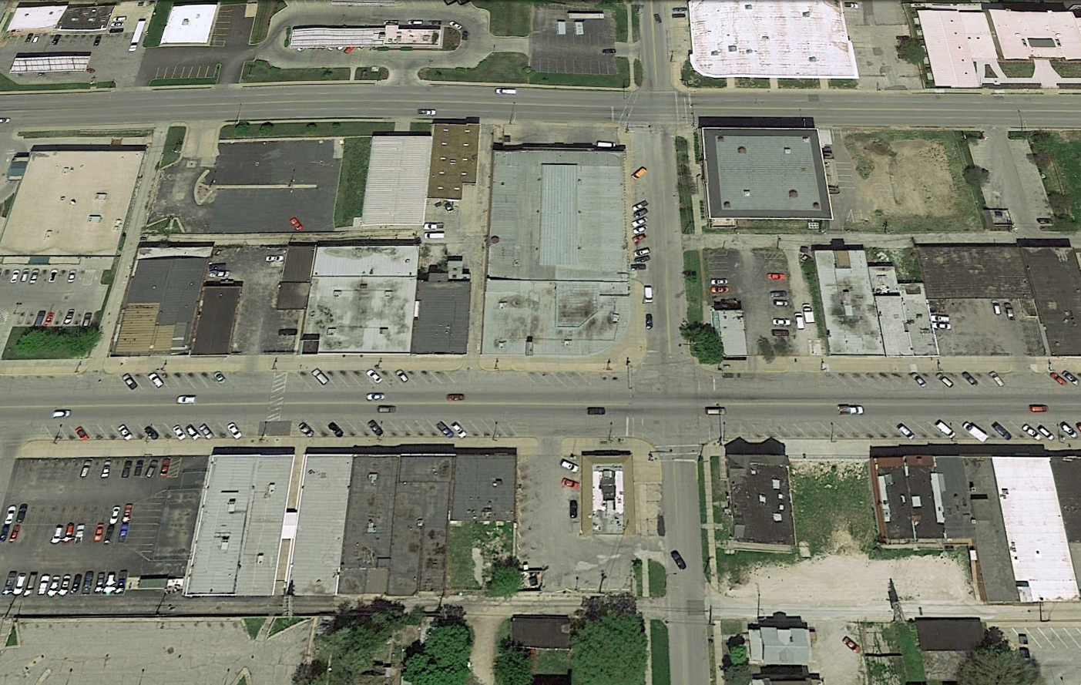
Location Tool (When to Use)
Local Point:
Use when you can conveniently position the device at the exact location to be measured
Avoid laser and compass error by taking device GPS reading
Target Position:
Use when the location is not easily accessible, such as behind a fence, across a creek, etc.
Target position is calculated using GPS coordinate, laser distance reading, and compass reading. It is less accurate than Local Point

Slide 29
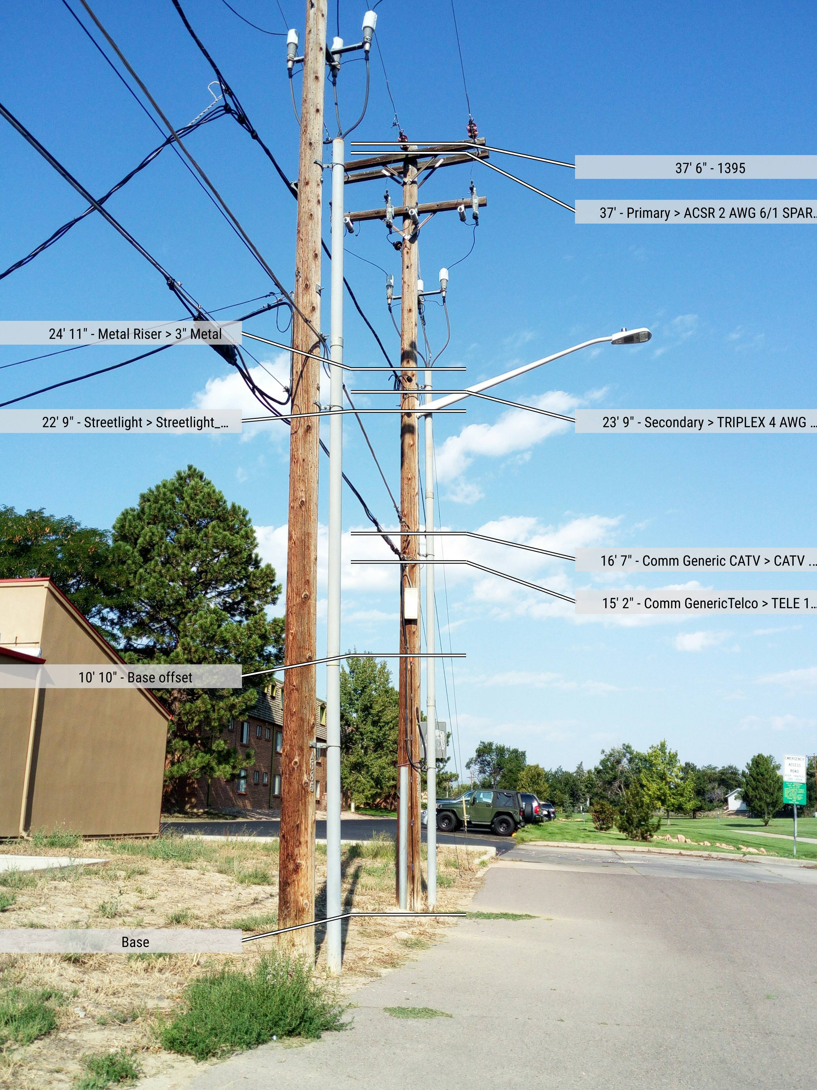
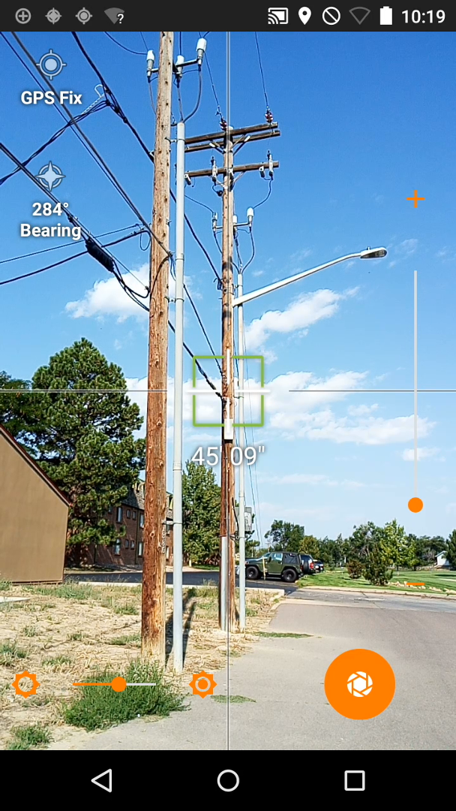
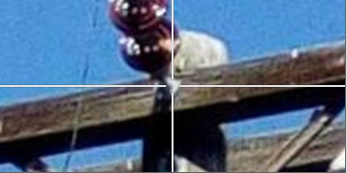

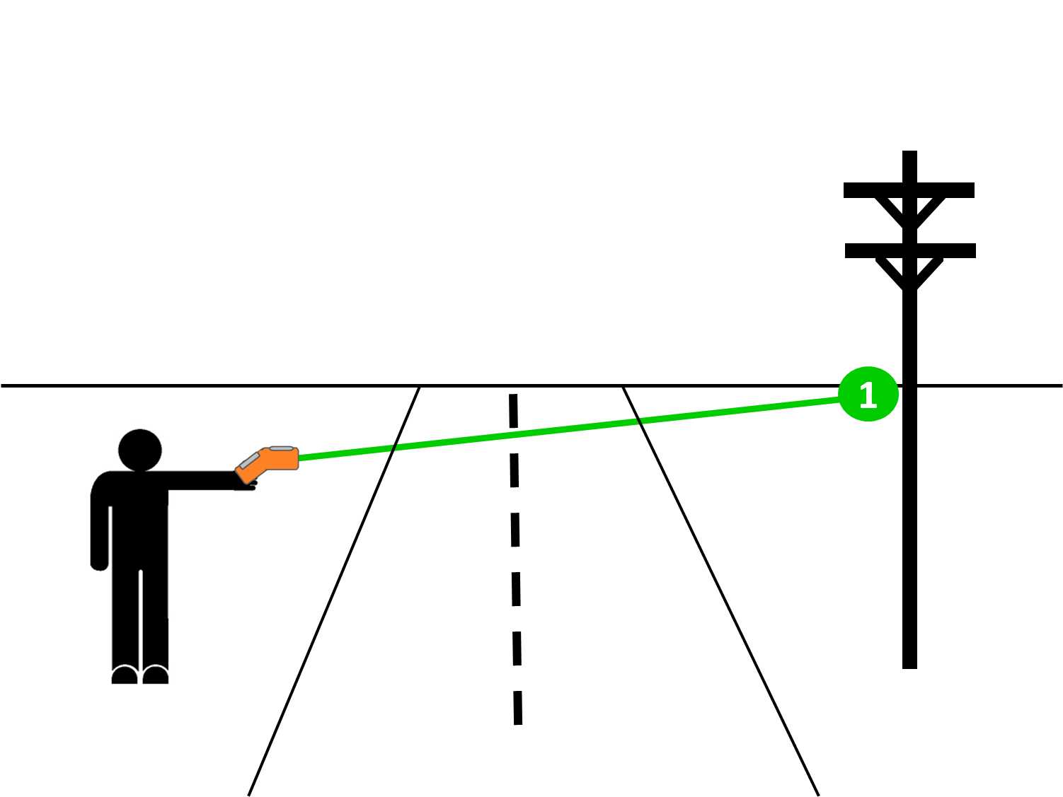
IKEphoto (Photo Measure)
Calibrated Photo
Measure Heights of Attachment in the Office
Edit/Add Missing Data
Target the Laser on the Pole
Line up Vertically with the Tip of the Pole
Attachment Points are on the “Face of the Pole”
IKEphoto

Slide 30
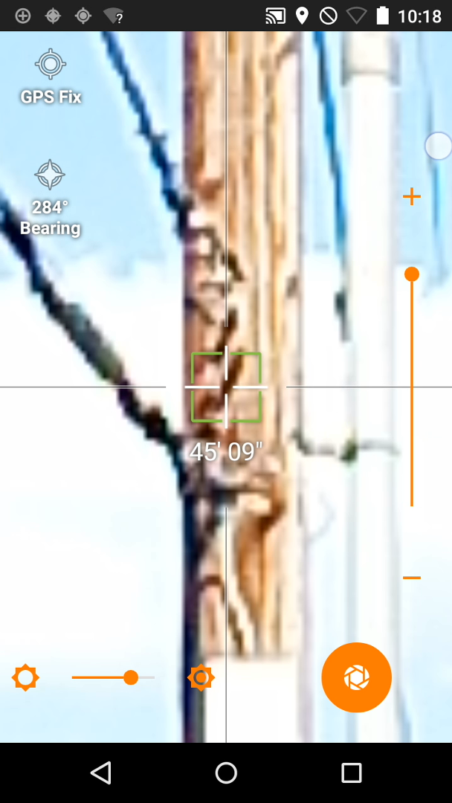
IKEphoto (Laser)
The laser needs to be centered on the pole itself
Do not target the laser on any piece of equipment (riser) or other attachments
Pay attention to the Distance Indicator below the target
Ensure that you have the correct distance from the device to where the laser is hitting on the pole
Distance Indicator

Slide 31
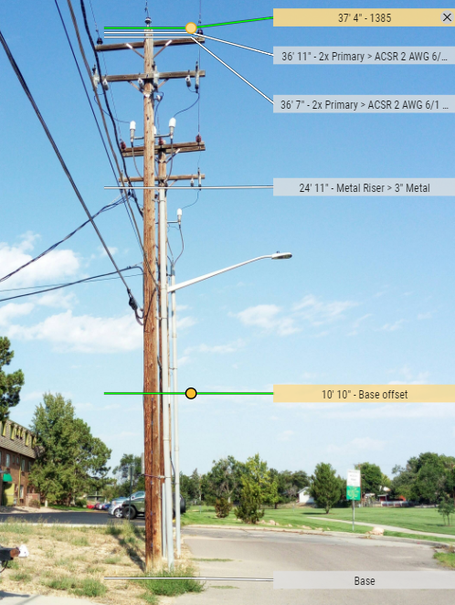
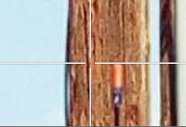
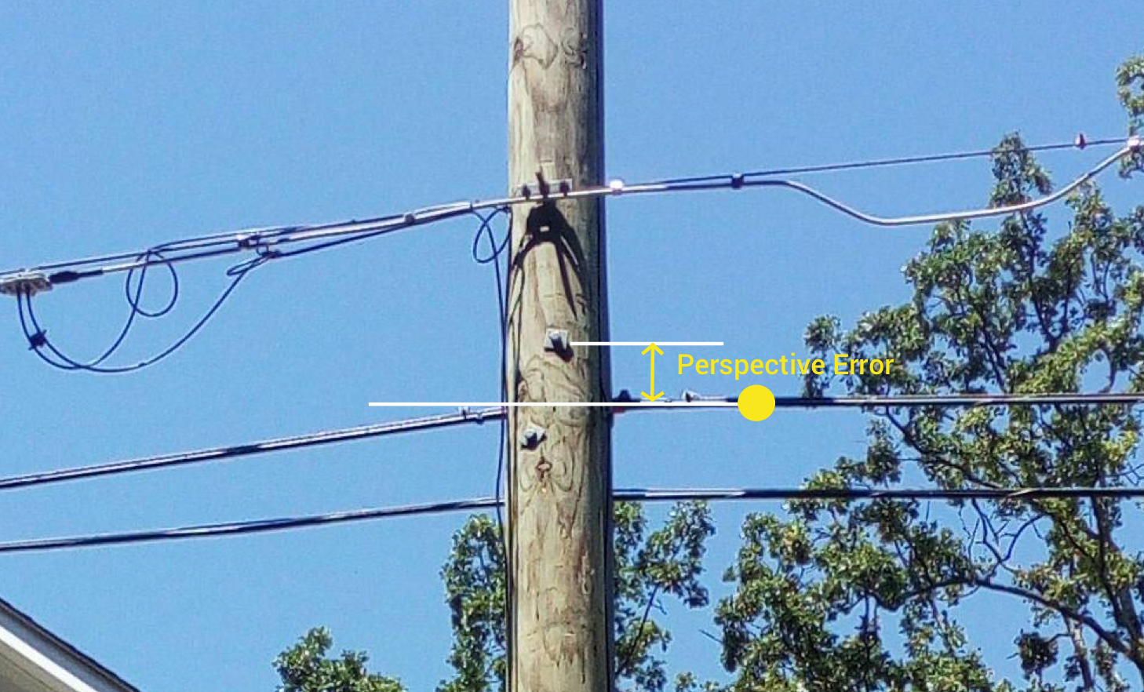
IKEphoto (Angles)
Use Base Offset Stick
Known Reference Height
Flat (butted up) against pole
Take from Multiple Angles
See attachment points on “Face of the Pole”
Adjust for Multiple Brightness Levels

Slide 32
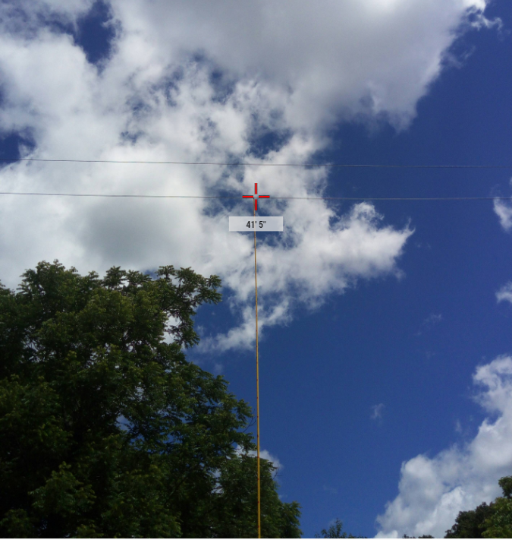
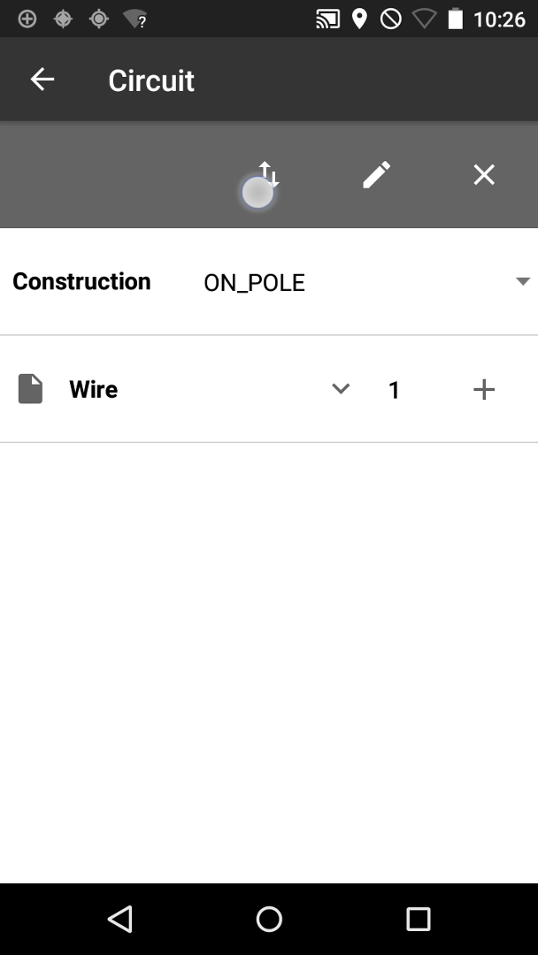
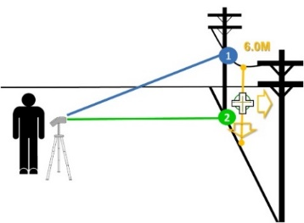


Height Tool
Vertical P2P Measurements
Height of Attachments
MidSpan Measurements
Arrows give you estimated Ground Reference Point
Gather Measurements Safely
No Touching Power Lines
Good for Road Clearances
Height
Height Tool
Manual Edit

Slide 33
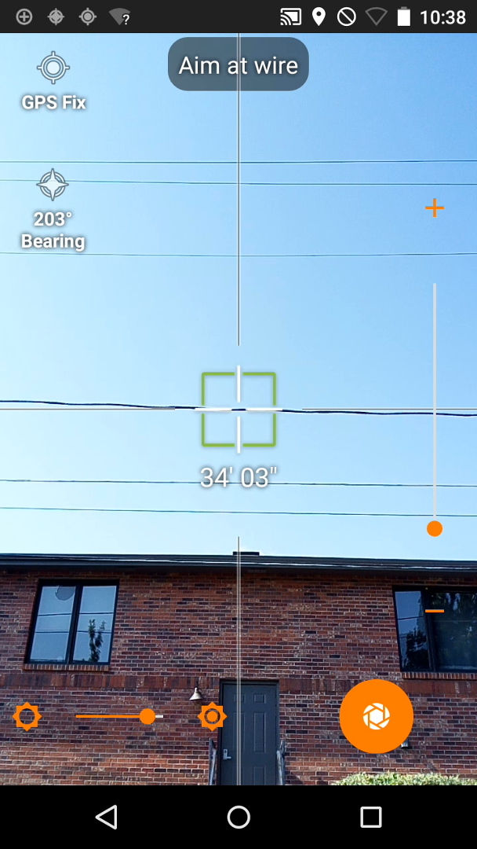
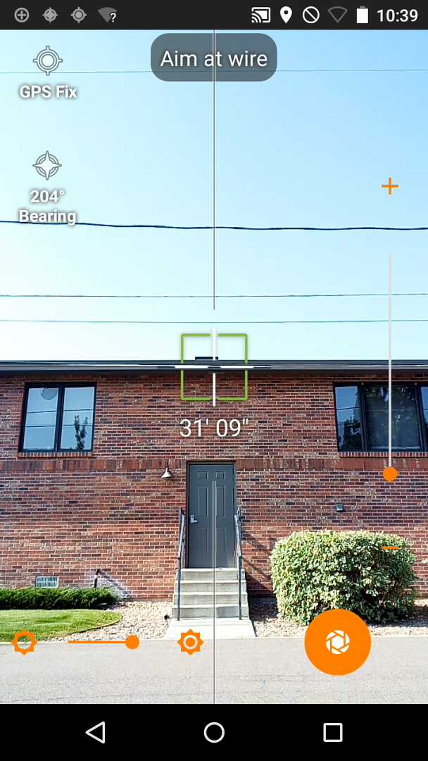
Height Tool (Appropriate Condition)
The Height tool can produce accurate span height measurements when:
There is no environmental interference to the target
For example, there should not be vegetation around the wire. Ideally, the wire to be measured is in a clear sky backdrop
There are no large structures such as building in close proximity of the wire
The ground is free of obstacles including grass or snow
Concrete ground would be an ideal situation

Slide 34
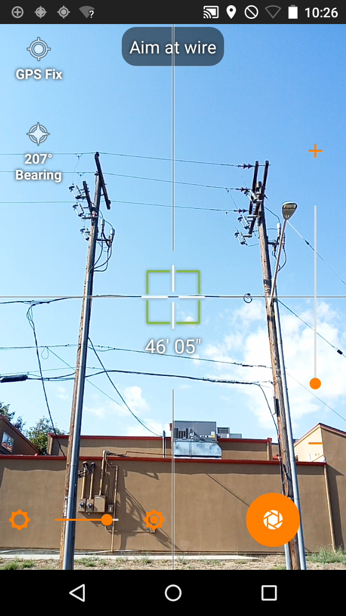
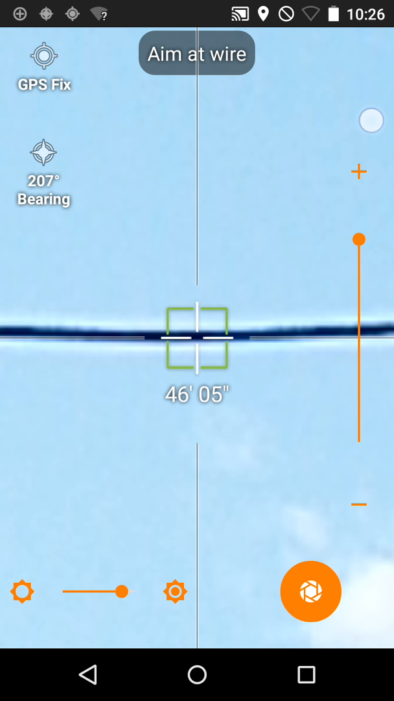
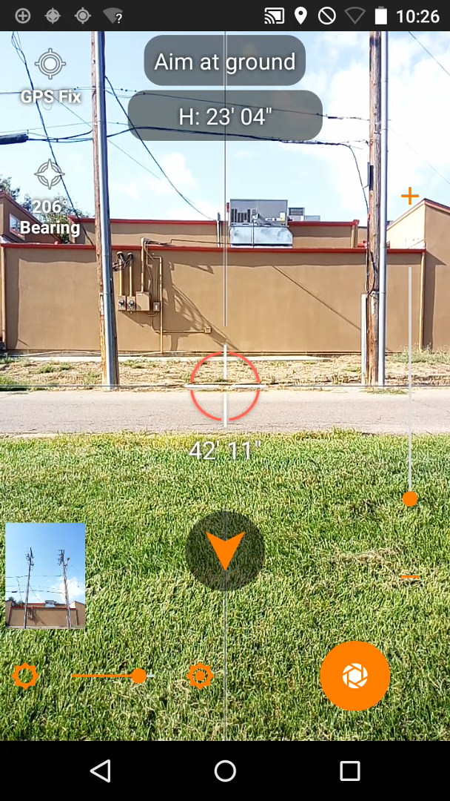
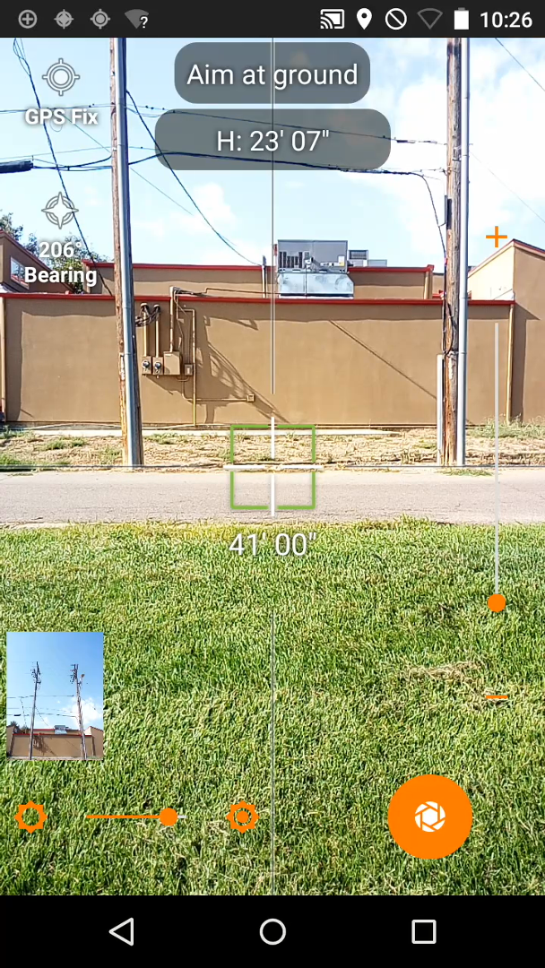
Height Tool (Best Practices)
Eliminate any large angles
Pay close attention to the Distance indicator to ensure that you are hitting the wire
Point A is the wire, and Point B will be the Ground (90 degrees) below the wire
The arrows directing you should disappear when you are directly below the wire

Slide 35
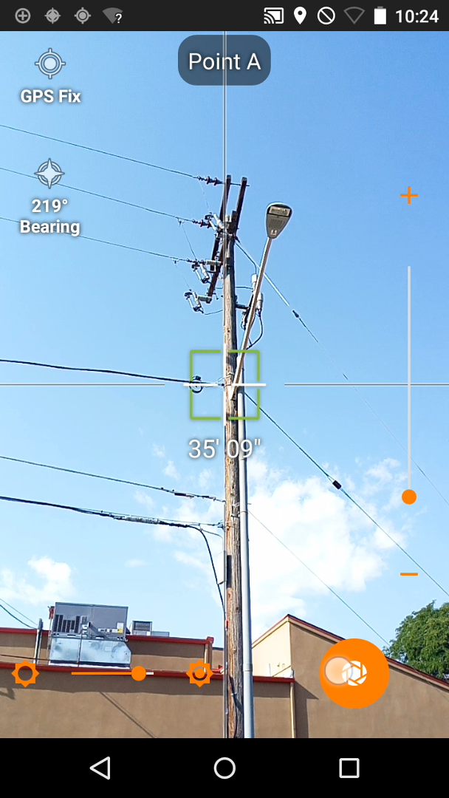
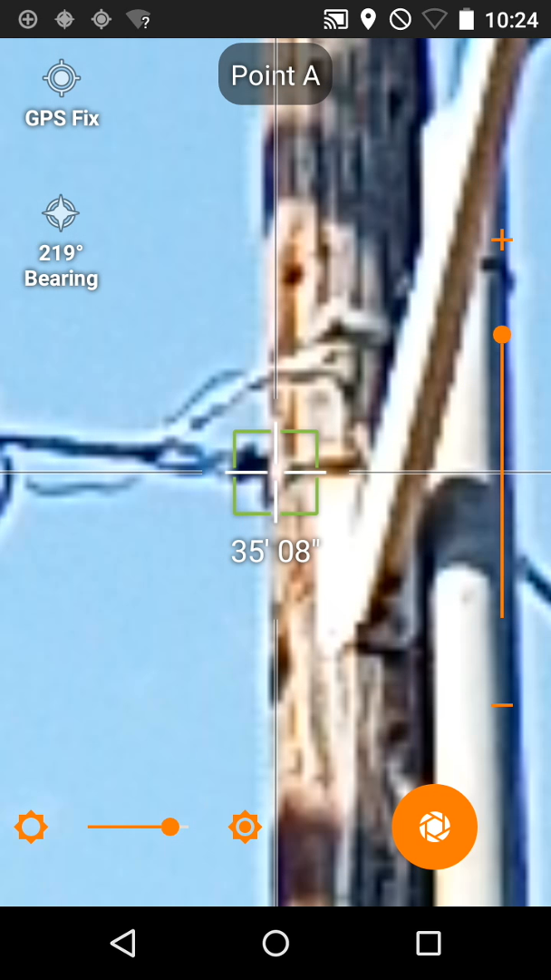
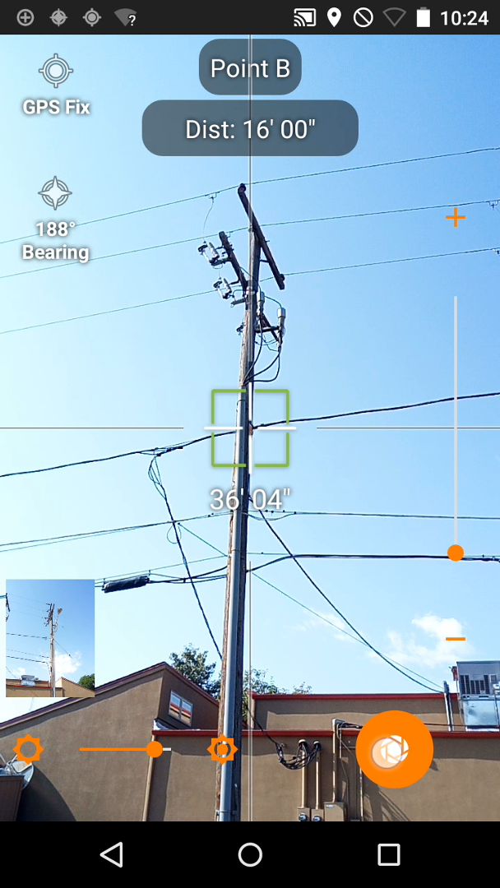
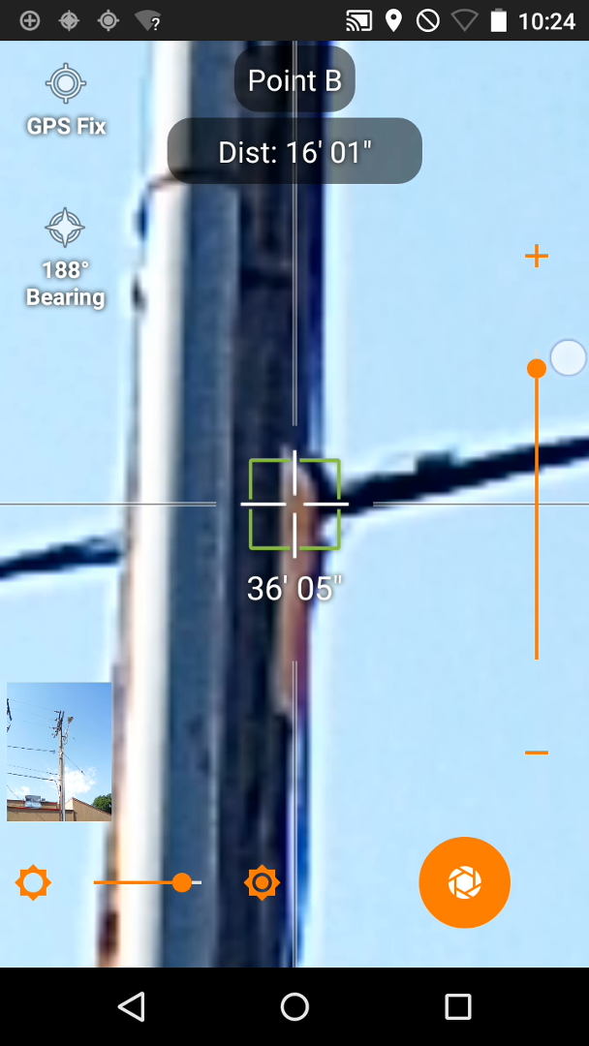
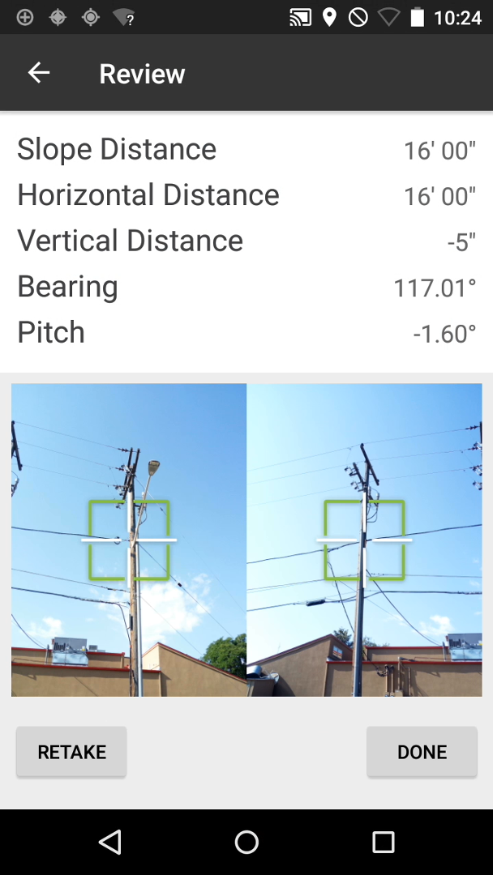
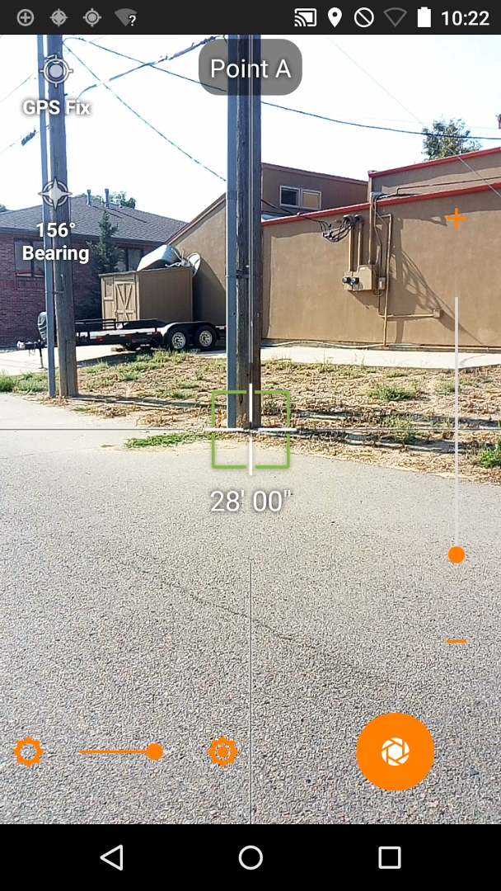
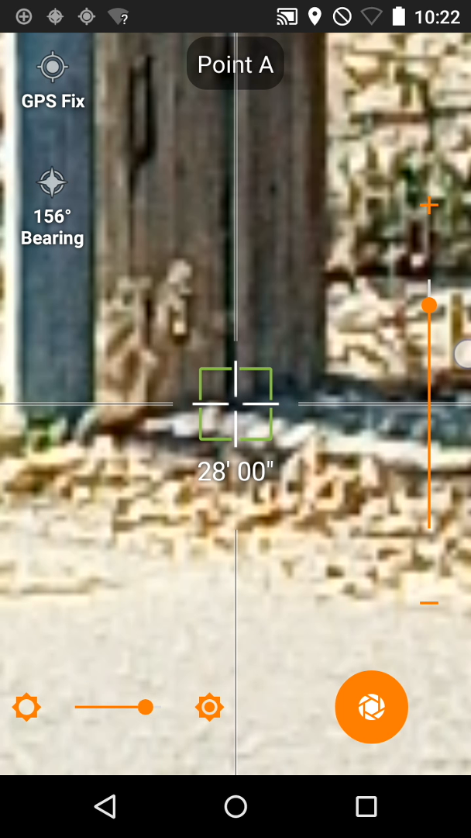




Vector Tool
Horizontal P2P Measurements
Slope Distance
Horizontal Distance
Vertical Distance
Bearing
Used for:
Clearances
Angles
Span Lengths
Anchor Lead Lengths
Vector

Slide 36
Vector Tool (Best Practices)
Choose a common point on both of the poles to take the horizontal distance
Use Communication to Communication Attachment Point, or Secondary to Secondary
Avoid using the Base of one pole to the Tip of the Other
Anchor Lead Lengths from the Inside Base of the Pole to where the Anchor is in the ground
Take the measurements as perpendicular to the wires as possible
Point A is always the pole that you are performing the inventory
Point B will be the other pole
Bearing is calculated from Point A to Point B
Pay attention to the Distance indicator to ensure that the laser has a good reading on the pole

Slide 37



Vector Tool (Where to Measure)
GOOD
B
A
B
BAD
A
A
B

Slide 38






Bearing Tool
Capture Equipment Bearing as it comes off the Pole
Directly face the Piece of Equipment
Target Laser on Equipment
Rotates Bearing
180 degrees
Bearing Tool
Bearing Tool

Slide 39
Completing Measurements in IKE Office

Slide 40



Process to Complete Measurements
Upload Field Data
To IKE Office via
Wi-Fi
Open Job in IKE Office
Open IKEphoto and use software to complete measurements

Slide 42

Jobs Screen

Slide 43

Collections Screen

Slide 44

Photo Measure Screen

Slide 45

Editing Data
Select On Item – Same Subforms in IKE Form

Slide 46

Editing P2P Measurements
Manually Type In:
Length (ft./in.)
Bearing

Slide 47



Copy From Existing Span
Data from 1st Span carried over in Mobile Device when “Cloneable” selected in IKE Form
Data labeled as ‘Fore’ or ‘Other’ on previous pole carried over in Office to ‘Back’ span of current pole

Slide 48

The BIG Map (View All Jobs)

Slide 49
Data Output

Slide 50

Data Output Formats
KML
EXCEL
JSON (API)
IKE Report (PDF)
Image Zip (per pole)
Pole Loading
SPIDACalc (JSON)
OCALC Pro (LCANX)
PoleForeman (JSON)

Slide 51

Selective Outputs (Per Pole, Selection of Poles)
To output individual poles or a selection of poles to the above formats, access the collections via the Jobs tab.
Once a Job has been selected, choose the individual collection by selecting the CheckBox next to the left of that selection.
Select the output ICON and choose the appropriate format
Individual Collection Checkbox

Slide 52



Output Entire Job
Output entire job directly from the MAP, Photo Measure Screen, or by selecting ALL collections in Collections Screen.

Slide 53

Output Multiple Jobs (Map Screen)
Select Multiple jobs for Output
Select Checkbox and Output Icon

Slide 54




Excel Output
Subforms will create individual Tabs
Excel Output Export

Slide 55



KML Output (Google Earth)
KML Output Export

Slide 56


IKE Report
IKE Report Export

